Slide 1
Writing Clip Library

Slide 2
Table of Contents
Building a Culture of Writing
Supporting writing with habits and routines
Silent Solo
Quiet, independent writing as a matter of habit
Everybody Writes
Frequent, informal formative writing prompts
Art of the Sentence
Developmental writing that strengthens syntactic control
Show Call
Studying student work with a lens of revision

Slide 3
Building a Culture of Writing Writing Clip Library

Slide 4
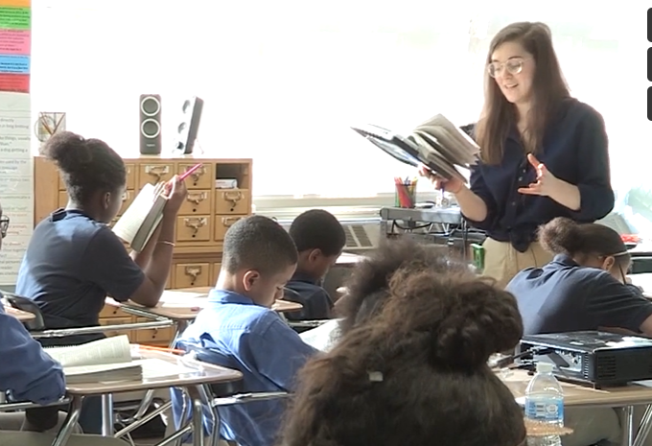
Julia Pearlman
What does Julia do as she circulates to build a strong culture of writing?
Notes:
Clip Title: EA.CFU.GR6.Pearlman.’The gate.’Clip2878
Context:
In this clip, Julia Pearlman leads Lesson 7 from the unit for Chains, written by Laurie Halse Anderson, with a 6th grade class in Brooklyn, NY.
As the clip opens, Julia reads aloud, then asks students to respond to a formative writing prompt in their student packets.
Alternative Framing Questions:
How does Julia provide differentiation as she circulates?
How does Julia check for understanding of this formative writing prompt?
In what ways does Julia support vocabulary development?

Slide 5
Julia Pearlman
Conveys both urgency and belief
Exemplar in hand
Individual feedback and scaffolding
Stamps key ideas
Names and celebrates exemplary work
Notes:
Notes on building a culture of writing:
Conveys both urgency and belief: Her positivity and enthusiasm in launching the task helps convey urgency and a positive belief in her students (“On your mark, get set, I don’t even need to say go because you’re already working hard”).
Exemplar in hand: Julia Actively Observes with pen in hand and an exemplar response to question number two. This allows her to free up her working memory to compare student responses to the already-established exemplar she carries and give quick, non-verbal praise (check marks with her pen) when students are on track.
Individual feedback and scaffolding: She moves to check in with a student who may need some additional support first and gives a scaffold (“Start your phrase: ‘This repetition builds…”).
Stamps key ideas: When Julia notices a trend in student responses, she launches a brief discussion to stamp key ideas.
Names and celebrates exemplary work: Before she moves on to the next question, Julia quickly praises students who used a vocabulary word in their writing, showing that she has attended closely to their work during observation.
You might also consider this clip for:
Read Aloud
Silent Solo
Cold Call/Share Out
FAQs:
What steps does Julia take to prepare to Actively Observe?
Julia’s ability to build culture in this moment relies on her thoughtful preparation. She has prewritten her exemplar and planned her prompts/sentences starters in advance, and she has installed systems of silent solo to support student writing and thinking.

Slide 6
Silent Solo Writing Clip Library

Slide 7
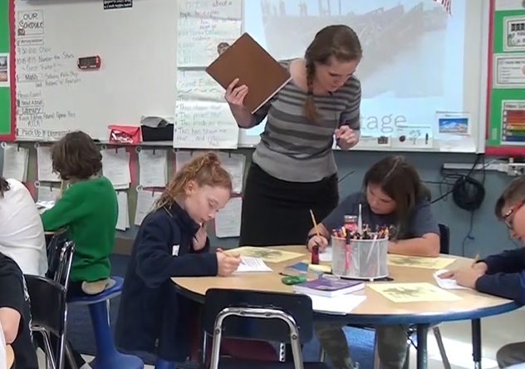
Emily Badillo
How does Emily ensure students are set up for success when working independently?
Notes:
Clip Title: EA.SilentSolo.GR4.Badillo.’Three minutes on your own.’Clip3157.PNP
Context:
In this clip, Emily Badillo leads Lesson 2 from the unit for Number the Stars, by Lois Lowry, with a fourth-grade class in Delmar, NY.
This is the second day of the novel unit, and students have just finished reading embedded nonfiction about the causes of World War II.
The class is using what they learned in the embedded nonfiction to answer the question: Who were the soldiers who stopped Annemarie and Ellen?
Alternative Framing Questions:
How does Emily provide differentiation as she circulates?
How does Emily nurture a culture of writing in this clip?

Slide 8
Emily Badillo
Clear directions with time limit
Anticipates and removes roadblocks
Actively monitors
Models productive quiet
Notes:
Notes on Silent Solo:
Clear directions with time limit: Emily gives simple, clear directions with a time limit, giving students sufficient time (three minutes) to complete the task but keeping it short enough to maximize students’ focus and attention.
Anticipates and removes roadblocks:
Emily sets up a challenge that students “get” to do if they’re done early. It’s framed positively (a challenge) and ensures that all students can stay busy for the entire time.
She tells one student who tries to answer verbally: “Don’t tell me, write it down.” Her tone is appreciative but also reinforces expectations for this time.
Emily reminds students of resources that they have (their text, previously learned vocabulary, knowledge organizer) that they can use so that they can work through the task independently.
Actively Observes: Emily’s instructions are warm, upbeat, and cheery. She first praises effort where she sees it, naming specific students so they feel seen and important (Ezra, Logan, others), then quickly transitions to reading quietly over students’ shoulders to show how much she values their ideas. As she circulates, she focuses on engaging student ideas and asks questions to show she’s reading carefully.
Models productive quiet: Emily also creates long stretches of silence in which to think and work. She makes and reinforces expectations but also honors the silence herself.
You might also consider this clip for:
Active Observation
Systems and Routines
FAQs for this clip:
What does the installation of Silent Solo look like?
Emily is teaching a guest lesson—this is not her regular classroom and it is the first time she has met these students—so this clip is a good example of early-stage Silent Solo. On Day 1, teachers might also consider shortening the bursts of independent work time, including additional What to Do directions, and/or providing more intentional praise and feedback about students’ habits while working.

Slide 9
Everybody Writes Writing Clip Library

Slide 10
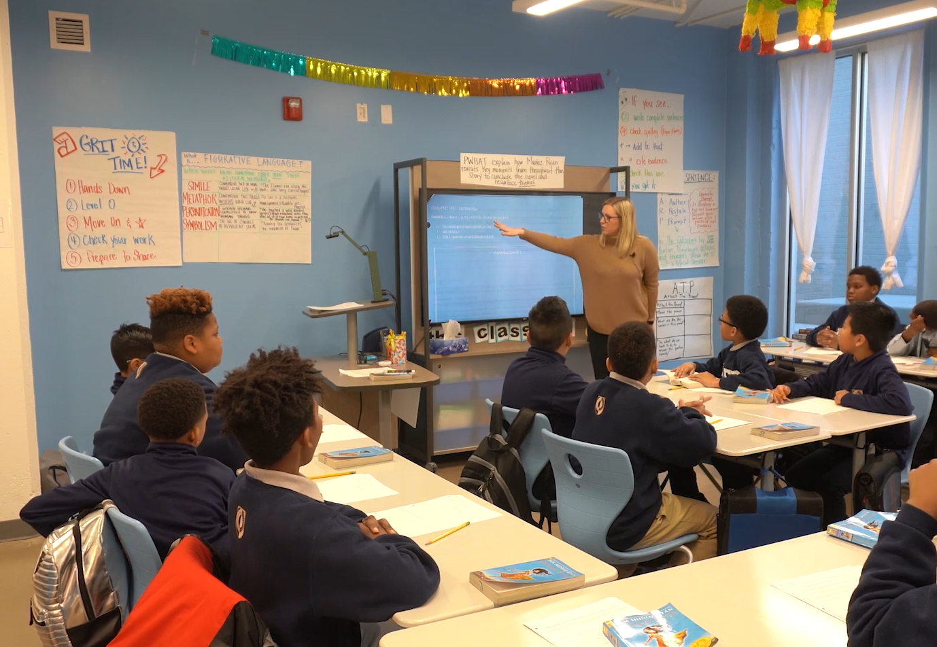
Sarah Wright
How does Sarah use Everybody Writes to improve the quality of discussion?
Notes:
Clip Title: EA.EverybodyWrites.GR6.Wright.’You are Tio Luis.’Clip2891
Context:
In this clip, Sarah Wright leads a lesson from the unit for Esperanza Rising, by Pam Munoz Ryan, with a 6th grade class in Chattanooga, TN.
Sarah is reviewing the Do Now from Lesson 27, which asks students to take the perspective of Tío Luis when he discovers Abuelita has disappeared. Students are challenged to use two vocabulary words of their choosing in their responses.
NOTE: While we don’t see students writing in this clip, they have written their responses prior to the discussion we see in the video.
Alternative Framing Questions:
How does Sarah use Turn and Talk to increase engagement?
How does Sarah maintain strong lesson pacing?
What does Sarah do to support the quality of student discussion?

Slide 11
Sarah Wright
Gives students space to process ideas first
Keeps Ratio high
Actively observes to find strong starting place
Supports writing, speaking, and listening
Notes:
Notes on Everybody Writes
Gives space to process ideas: Sarah asks students to respond in writing to a low-stakes formative question (“Imagine what he might say to himself…”) that allows space for students to process ideas before sharing them.
Keeps engagement high: The Everybody Writes question invites all students in, increasing both engagement and rigor.
Actively Observes to find strong starting place: During the Everybody Writes and Turn and Talk, Sarah Actively Observes to select the most productive responses to begin the whole group discussion.
Supports writing, speaking, and listening: By the time Sarah reaches the whole group discussion, what gets shared aloud is a third draft of student thinking. Not only is it of higher quality, but sharing responses is also a lighter cognitive lift, allowing students to listen to their classmates more authentically.
You might also consider this clip for:
Turn and Talk
Discussion
Active Observation

Slide 12
Show Call Writing Clip Library

Slide 13
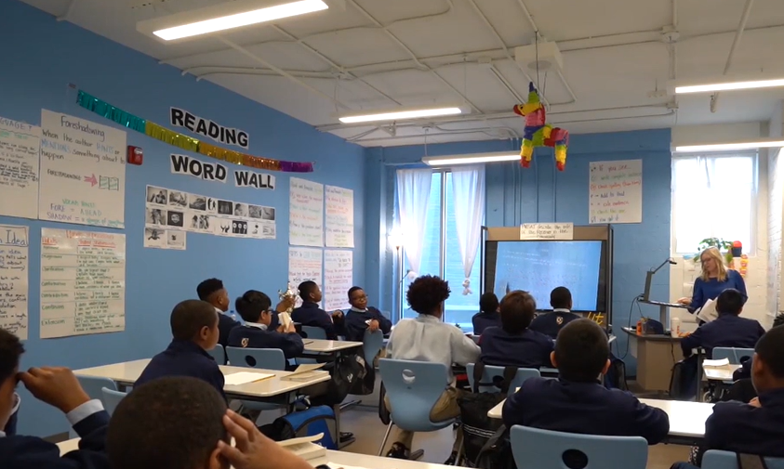
Sarah Wright
How does Sarah use Show Call to support understanding of a key moment in the text?
Notes:
Clip Title: Sarah Wright Show Call
Context:
In this clip, Sarah Wright leads a lesson from the unit for The Giver, by Lois Lowry, with a sixth-grade class in Chattanooga, TN.
Sarah is teaching Lesson 11, and students are analyzing how Jonas feels as he prepares to meet The Receiver.
Alternative Framing Questions:
How does Sarah build a culture of error?

Slide 14
Sarah Wright
Show Call is an entry point to discussion
Emphasizes positivity and teamwork
Culture of Error
Opportunity to revise thinking
Notes:
Notes on Show Call:
Show Call is an entry point to discussion: Sarah reads a student’s unfinished response and asks the class to help finish the thinking.
Emphasizes positivity and teamwork: “Corian has us started…” - not “Corian didn’t finish.” “We are going to help Corian finish his answer.” Sarah uses “we” instead of “you” or “I.”
Culture of Error: She also shows emotional constancy - she treats this as completely normal. Corian is not in trouble.
Gives opportunity to revise thinking: She reveals that “some students are getting this down” - highlighting that many students were struggling with this question and giving them another chance to work through it. She also offers a push for those who were already there (“Some students are ready to add on to this”) to push the group to expand and elaborate on each other’s thinking.
You might also consider this clip for:
Culture of Error
FAQs:
How does Sarah build a culture where students feel comfortable participating?
If Show Call is new in a classroom, you might consider starting by showing only exemplary work to establish a culture of sharing and celebrating student work, then gradually work towards Show Calling an “almost-there” answer for revision. It is important that both the “Take” (the moment when we take a student’s work to Show Call and the “Reveal” (the moment when we show student work to the class) are warm and positively framed.

