Slide 1
Ways of Reading & Annotating Clip Library

Slide 2
Table of Contents
Read Aloud
Modeling fluency & sharing in the joy of reading
FASE Reading
A system for shared oral reading that cultivates a culture in which reading is fluent, accountable, social, and expressive
Accountable Independent Reading (AIR)
Students read independently with a specific focus or task in mind.
Annotation
Marking up text to illuminate student thinking

Slide 3
Read Aloud Ways of Reading & Annotating Clip Library

Slide 4
Christine Torres & Kait Smith
Why might Christine have chosen this moment for a
Read Aloud?
Notes:
Clip Title: RC.ReadAloud.GR5.Torres.Smith.’Comicrelief’.Clip3018
Context:
In this clip, Christine is reading Number the Stars with her 5th grade class along with her co-teacher, Kait.
After a stretch of FASE Reading, Kait reads aloud the end of a climactic chapter.
Alternative Framing Questions:
How does using Read Aloud positively impact students’ experience of this moment of text?

Slide 5
Christine Torres & Kait Smith
Evidence of planning and preparation
Shared joy of reading
Opportunity to boost vocabulary
Notes:
Notes on Read Aloud:
Evidence of planning and preparation: Choosing to read this moment aloud, one that marks an important event of the story, means students can both enjoy the humorous moment together and ensures that all students have shared access to this part of the plot. Choosing to have both teachers deliver this moment in the lesson is also evidence of strong preparation.
Shared joy of reading: Torres sees students smile and we hear audible giggles in reaction to this moment in the story. This is a great example of how Read Aloud helps students engage with (and love!) more difficult texts.
Opportunity to boost vocabulary: She uses this moment of the text, a moment that naturally draws students in, to drop in a new way to describe moments like these in stories – ‘comic relief.’
You might also consider this clip for:
Knowledge Building

Slide 6
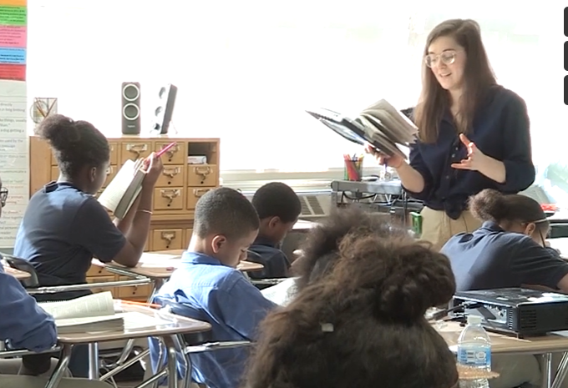
Julia Pearlman
What is effective about Julia’s Read Aloud?
Notes:
Clip Title: EA.CFU.GR6.Pearlman.’The gate.’Clip2878
Context:
In this clip, Julia Pearlman leads Lesson 7 from the unit for Chains, written by Laurie Halse Anderson, with a 6th grade class in Brooklyn, NY.
As the clip opens, Julia reads aloud, then asks students to respond to a formative writing prompt in their student packets.
Alternative Framing Questions:
How does Julia set students up for extended independent writing?
In what ways does Julia support vocabulary development?

Slide 7
Julia Pearlman
Models fluent expressive reading
Pairs with literal and analysis tasks
Conveys both urgency and belief
Notes:
Notes on Read Aloud:
Models fluent expressive reading: Julia’s reading draws students in – she is able to add meaning by the way she slows down to add emphasis to “When I opened the gate” and build suspense when she whispers “…and ran.”
Pairs with both literal and analysis tasks: Julia also pairs this Read Aloud with both a literal (“Make a quick summary margin note”) and an analysis task (“Dig in deeply to the choices Anderson is making”)
Conveys both urgency and belief: Her positivity and enthusiasm in launching the analysis task helps convey urgency and a positive belief in her students (“On your mark, get set, I don’t even need to say go because you’re already working hard”).
You might also consider this clip for:
Building a Culture of Writing
Silent Solo
Cold Call/Share Out
FAQs:
What steps does Julia take to prepare to Actively Observe?
Julia’s ability to build culture in this moment relies on her thoughtful preparation. She has prewritten her exemplar and planned her prompts/sentences starters in advance, and she has installed systems of silent solo to support student writing and thinking.

Slide 8
Kristin Curran
How might a Read Aloud support nonfiction comprehension?
Notes:
Clip Title: Reading.ReadAloud.EmbeddingNonFiction.GR5.Curran.'Nazi violence against Jews.'Clip3360.mp4
Context:
In this clip, Kristin and her class engage in a nonfiction embedding about the Nazi party’s persecution of Jewish people during the Holocaust. This is one of the first lessons in the Number the Stars unit.
Alternative Framing Questions:
What might Kristin’s planning might have looked like for this moment in the lesson?
How might Kristin have achieved such high engagement in a challenging nonfiction text?
How does Kristin support student engagement and comprehension when reading an embedded text?

Slide 9
Kristin Curran
Establishes meaning during reading
Provides concrete and observable annotation task
Illuminates nonfiction’s set of unwritten rules
Drops in vocabulary at just the right moment
Increases engagement through expressive Read Aloud
Notes:
Notes on Read Aloud:
Establishes meaning during reading It is particularly important to pause and establish meaning while reading nonfiction texts and Kristin has planned strategic stopping points where she anticipates literal understanding might be lost. She establishes meaning quickly and efficiently and then moves on.
Provides concrete and observable annotation task: Kristin also asks her students to annotate, which not only gives students a way to focus their thinking, but is a way for this same thinking to be visible to Kristin as she Actively Observes.
Illuminates nonfiction’s set of unwritten rules: Nonfiction has its own unwritten rules and stylistic conventions – the way end notes work, for example. Reading an article aloud helps students hear these rules and conventions, and makes it more likely that subsequent reading will accurately capture a text’s tone and meaning.
Provides definitions for challenging and critical vocabulary words: Kristin is able to drop in or emphasize the definitions of words – like ‘discriminatory’ or ‘segregated’ here, for example - that may be a roadblock to comprehension at just the moment students need them. This also helps students prioritize what concepts are most important.
Increases engagement through expressive Read Aloud: While Read Alouds can feel like a more natural fit for fiction, reading nonfiction texts aloud enables the best reader in the room (the teacher) is able to breath life into the text by modeling fluency and creating meaning.
You might also consider this clip for:
Implicit vocabulary instruction
Knowledge Building
FAQs:
What might Ms. Curran’s planning have looked like?
Ms. Curran’s ability to engage students in this challenging text relies on her thoughtful preparation. She has prewritten her prompts and moments where she will pause in the text. She has also previously installed systems of Read Aloud so students know how to annotate and what her classroom should look and sound like when she is Reading Aloud.

Slide 10
Chelsea Emerson
What is effective about Chelsea’s Read Aloud?
Notes:
Clip Title: Reading.FormatsOfReading.GR8.Emerson.'Comrades.'Clip2845
Context:
Chelsea is teaching Animal Farm to her group of 8th graders. In this clip, she reads aloud Old Major’s speech to the animals.
Alternative Framing Questions:
What planning needed to happen before Chelsea began this Read Aloud?

Slide 11
Chelsea Emerson
Reads expressively to capture the drama
Cues students to chorally participate
Notes:
Notes on Read Aloud:
Reads expressively to capture the drama: Building fluency might look like the modeling expression, enthusiasm, and fluidity. Here, Chelsea embodies the voice of the characters to bring the text alive. Reading with expression also helps build a culture of reading with students by conveying your own love and passion for the text or author. A genuinely passionate teacher can make us love books we might never have expected to care about.
Cues students to participate chorally: Chelsea invites student participation when she pauses for students to read chorally. She has previously taught this nonverbal so that its seamless in its execution and allows students to remain focused on the narrative. It also serves as a way for her to gauge if students are still engaged and following along as she reads.

Slide 12
Read Aloud Montage
What steals or adaptations do you have after watching this montage?
Notes:
Clip Title: RCReadAloudGRMMultipleTeachers'Read Aloud Montage'Clip2963
Context:
In this clip, you’ll five teachers facilitating Read Aloud in various settings.
Some of the clips you’ll see are bridging during FASE Reading.
Alternative Framing Questions:
What makes Read Aloud effective in these teachers’ classrooms?

Slide 13
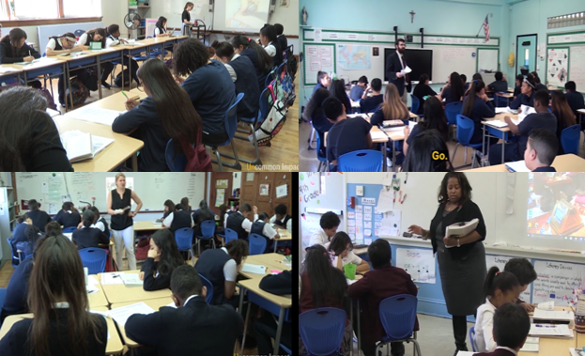
Read Aloud Montage
Teachers model a love for reading
Established culture of Read Aloud
Intentionally planned
Notes:
Notes on Read Alouds:
Teachers model love for reading: Students get to observe their teacher experiencing a book with evident enjoyment, which builds a culture that publicly celebrates reading. You’ll notice that these students are in late elementary or middle school – reading aloud isn’t just for our youngest students.
Established culture of Read Aloud: Intentional systems for Read Aloud have been put in place in each of these classrooms. Students are often annotating as the teacher reads, prompted to read chorally, or ready to transition to FASE reading easily.
Intentionally planned: We see that the teachers have planned precisely when and how they are going to Read Aloud and how students should engage in the text as they listen. We see this when teachers choose a particular chunk of text that is best for a Read Aloud, when Read Alouds are paired with FASE Reading, when planned questions are dropped in at strategic moments in the text so students have support establishing meaning, or when teachers pause to embed a gem of knowledge.
You might also consider this clip for:
Academic systems

Slide 14
FASE Reading Ways of Reading & Annotating Clip Library

Slide 15
Maggie Johnson
How does Maggie’s system for FASE Reading support students in reading aloud successfully?
Notes:
Clip Title: Reading.ControlTheGame.GR8.Johnson.'Grew serious.'Clip2058
Context:
In this clip, Maggie Johnson is reading To Kill a Mockingbird with her 8th graders.
Alternative Framing Questions:
How does FASE Reading in Maggie’s class build students’ fluency and expressiveness?

Slide 16
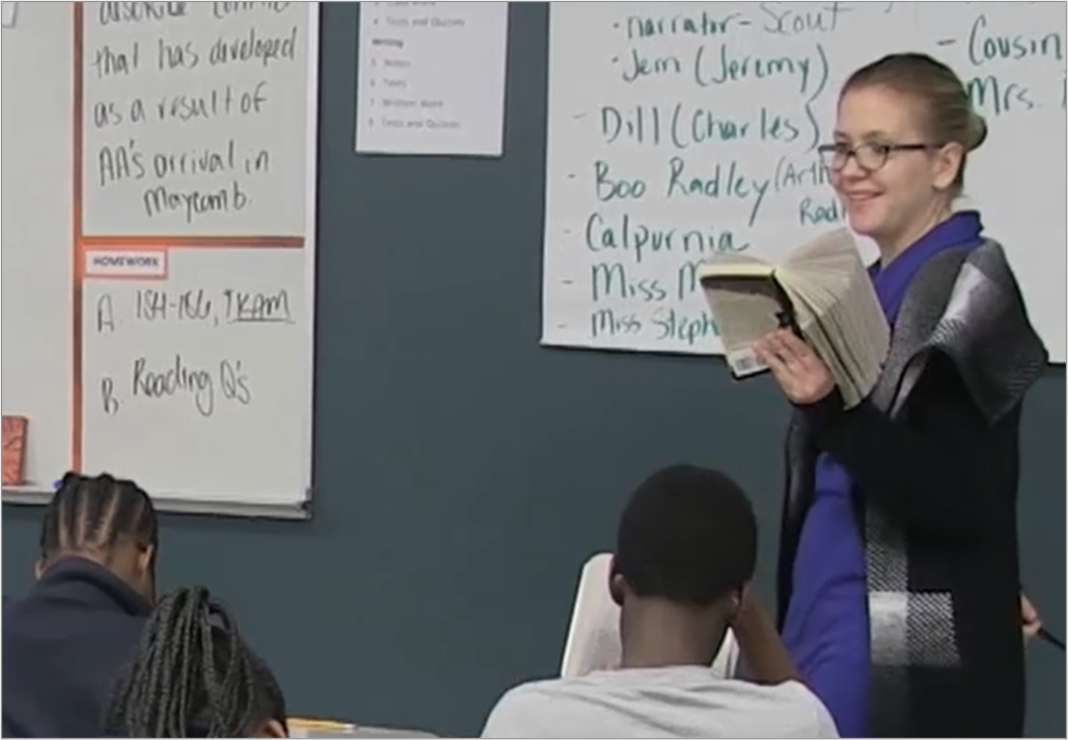
Maggie Johnson
Facilitates an established system
Models expressive, fluent reading
Students practice reading aloud (with fluency prompting!)
Connects to the meaning of the text (“an irritated Atticus”)
Smiles and laughs of appreciation: reading is shared and social
Notes:
Notes on FASE Reading:
Facilitates a system of shared reading: Maggie is leaning on an already-installed system that reinforces reading that is Fluent, Accountable, Social, and Expressive. The systems is predictable and comfortable.
Models expressive, fluent reading: We see Maggie effectively focus on fluency when she starts this stretch of FASE Reading by modeling what it looks like to read with the kind of fluency and expression that conveys (and even deepens) comprehension.
Students practice reading aloud (with fluency prompting!):
Maggie then quickly and efficiently prompts students to pick up and continue the oral reading by saying their name. In doing so, she efficiently switches between readers. Note that every student is ready to pick up and read at her cue, which provides Maggie with strong evidence that students are closely attending to the text.
When Maggie calls on Aarshea, he reads without much expression. She then says: “You can give me a little more than that…” Aarshea rereads with a lot more spunk, and Maggie and her students laugh appreciatively. Even though the class is knee-deep in a challenging text, Maggie makes sure students don’t forget to enjoy reading with fluency and expression.
When she calls on the second student, a struggling reader, she offers some reassuring hums each time the student successfully pronounces tricky words. This boosts the student’s confidence and also helps Maggie maintain the pace of the oral reading.
When the student makes a decoding mistakes, she Punches the Error: “Not grow serious, it’s…” and then asks her to reread that sentence. Consequently, the student gets to practice being successful.
Connects to the meaning of the text (“an irritated Atticus”): She then Positively Frames her request for fluent reading when she says, “I need an irritated Atticus. Who wants it?” In doing so, she clarifies what she’s looking for in a reader while turning the task into a reward. We then see Ronnie rise to the occasion when he reads the line “Stop that noise!” with convincing expression.
Smiles and laughs of appreciation; reading is shared and social: By making FASE Reading a system, reading aloud is predictable and comfortable and, therefore, shapes a joyful culture of reading and belonging. Remember the laughter over the funny moments in Maggie’s class – the delight of sharing a great story with friends. In fact, this is where stories started, as a form of culture building. Experiencing a book or story is a particularly emotional experience. Reading together means sharing profound experiences and this forms group belonging. It also also reminds us that books and stories can be the glue of that belonging.
You might also consider this clip for:
Modeling fluency
FAQs for this clip:
What does the installation of FASE Reading look like?

Slide 17
AIR Ways of Reading & Annotating Clip Library

Slide 18
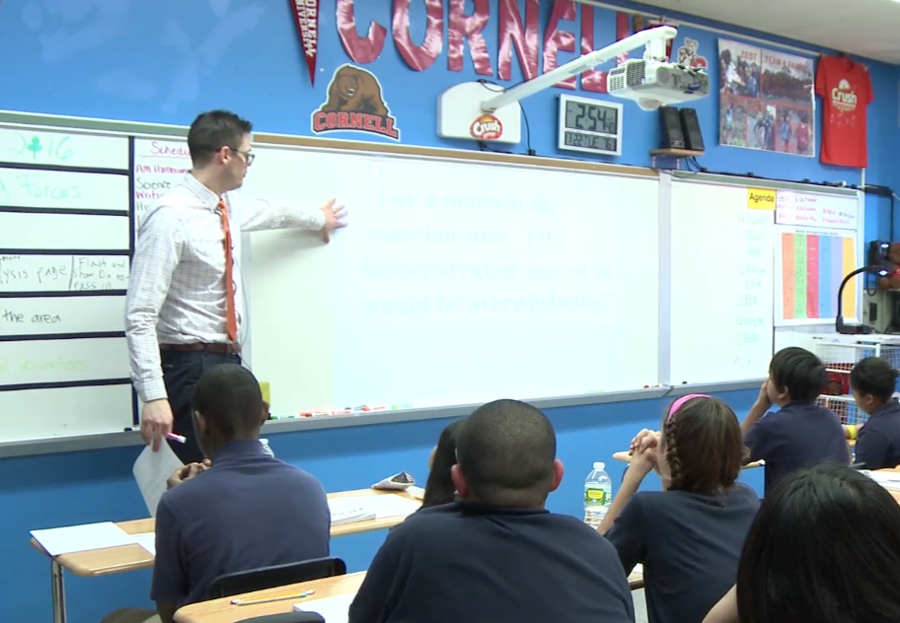
Eric Snider
What’s effective about Eric’s implementation of AIR?
Notes:
Clip Title: Reading.AIR.GR8.Snider.'Final scene.'Clip2661
Context:
In this clip, Eric Snider 8th grade teacher at Achievement First Bushwick asks his students to read the final scene in their texts about Hector and Achilles.
Alternative Framing Questions:
How does Eric Actively Observe as students read?
What does Eric do to support reading stamina?

Slide 19
Eric Snider
Short, intentionally chosen section of text
Specific, observable annotation task
Individual feedback and differentiated support
Pacing markers support stamina building and attentive reading
Notes:
Notes on AIR:
Short, intentionally chosen section of the text: Eric gives his students a specific amount of text to read (two stanzas) to manage their independent reading time. He even marks up the text prior to students reading by putting the word “start” where he wants his students to begin reading.
Research on Deliberate Practice indicates that short frequent bouts of spaced intensive practice at a complex task are more effective than the same amount of practice given in sustained chunks. Keeping the duration short helps us push the rigor and avoid overloading working memory and maximize perception.
Specific, observable annotation task: Eric also asks his students for annotations using their classroom expectations, presumably written on the board (which he points out in the clip). Giving students something to think about while reading gives them a point of focus and helps us see their progress.
Individual feedback and differentiated support: The annotation task (“Annotate for the CFS” [Criteria for Success”]) also doubles as a built-in scaffold, giving students a breakdown of what they should be looking for as they read. Eric also narrates what students who are being successful are finding and gives individual prompts (“What does that tell you?”) as he Actively Observes.
Pacing markers support stamina building and attentive reading: As students work, Eric tells them if they are on track and how much time they have left to complete the reading task he’s given. He says, “We’re all in the right spots here on the top of 553” to affirm their progress and then, later, follows up with “We’re in great shape here, pacing wise…”
You might also consider this clip for:
Active Observation
FAQs:
What does the installation of effective AIR look like?
We believe there are three pillars to successfully implement AIR: gradual release, self-awareness, and accountability and monitoring
Gradual release: I mentioned length of the chunk as one way to increase independence, but as students get more comfortable with a text, you might also shift from more literal to analytical questions, or increase the lag time between reading and follow-up.
Self-Awareness: Help students take increasing ownership over their independent reading. There’s value in being transparent about students’ successes and challenges, as well as how and why we’re managing AIR time (a teacher might say e.g., “My sense is that we’re still figuring Douglass out. We’re going to keep reading independently in small chunks until we’re a bit more familiar with his style and voice,” or “We’re really starting to ‘get’ Douglass. I’m going to challenge you to do more on your own.”).
Accountability: Giving students something to think about while reading gives them a point of focus and helps us see their progress. Usually, we recommended annotation tasks or focus questions accompany each chunk of reading.

Slide 20
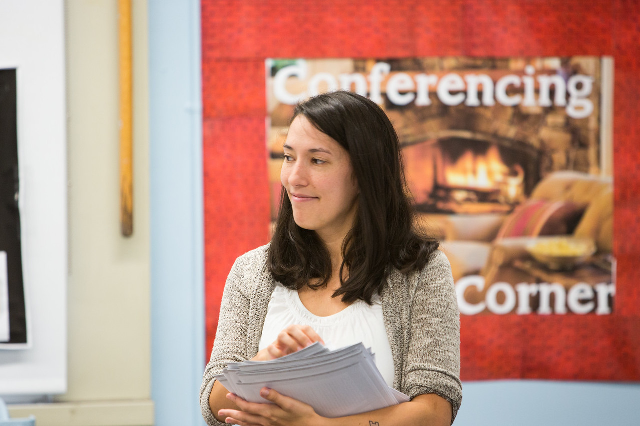
Kirby Jarrell
How does Kirby set her students up for success in their independent reading of a complex text?
Notes:
Clip Title: Reading.AIR.GR7.Jarrell.'A Doubtful Freedom.'Clip2908
Context:
In this clip, Kirby is reading Narrative of the Life of Frederick Douglass with her 7th graders at Achievement First Bushwick Middle School.
Narrative of the Life of Frederick Douglass was written in 1845 and contains complex syntax and vocabulary.
It’s toward the end of the unit; students have been working with the text for about 3 weeks.
Alternative Framing Questions:
How does Kirby help students see the progress they’ve made reading complex text independently?
How does Kirby enable her students to independently read and understand complex text with confidence?

Slide 21
Kirby Jarrell
Specific, observable annotation task
Individual feedback and differentiated support
Names and celebrates the challenge and progress
“Stamps” in writing to lock in accurate thinking
Notes:
Notes on AIR:
Specific, observable task: Before students read, Kirby gives specific guidelines for annotating as well as a focus question, asking students to underline lists in the paragraph and consider why Douglass includes those lists. This not only ensures that students are reading with purpose, but also holds them accountable for reading and annotating carefully. By posting these guidelines at the front of the room, Kirby helps students stay on task and gives them a resource that they can refer back to while reading.
Individual feedback and differentiated support: As students read, Kirby reinforces accountability by actively circulating to gather data and providing students feedback on their written work. She jots notes to herself as she circulates, which allows her to gauge and record student understanding and determine the focus and structure of the following discussion.
Names and celebrates the challenge and progress: At the conclusion of independent reading, Kirby warmly praises the success she saw while circulating, saying, “Incredible…Awesome job. You don’t need a partner, you’ve really got it.” This praise accomplishes three important things:
Affirms for students the value and success of tackling this difficult text independently and without help.
Sets the expectation that students will engage confidently and enthusiastically in the conversation that follows.
And, because she has circulated so carefully during reading, Kirby is able to warmly hold students accountable in raising their hands to participate (“Do you know? I feel like you know.”)
At the end of the clip, Kirby takes a few seconds to acknowledge students’ progress with the text. They’ve been working with Douglass for weeks and can now independently unpack dense text that may have stumped them at the beginning of the unit. It’s a small but powerful move that makes transparent for students the struggle and value of working independently with rigorous language.
“Stamps” in writing to lock in accurate thinking: Kirby is able to use the data she collected during reading to intentionally and efficiently tailor her conversation to quickly address misconceptions and surface the key ideas of the paragraph. She locks in student learning with a final, written stamp: “Jot at the bottom of your paper: He’s imagining _____.”
You might also consider this clip for:
Active Observation
Culture of Reading

Slide 22
Trista Rivera
What makes Trista’s stretch of AIR effective?
Notes:
Clip Title: RC.AIR.GR8.Rivera.'Rather coldly.'Clip2962
Context:
In this clip, Trista is reading The Magician’s Nephew with her 8th grade students at Immaculate Conception in New York.
Alternative Framing Questions:
How does Trista use annotation tasks to support students as they read?

Slide 23
Trista Rivera
Gives clear What To Do directions
Focused feedback
Strategic whole group facilitation
Notes:
Notes on AIR:
Gives clear What To Do directions: Trista gives clear What To Do directions by telling students they will be reading pages 80-81 in the novel independently – and even adding in a touch of expressive reading as she does so. She then provides focal point questions in their packet. She gives a specific time parameter (14 minutes) for student reading and answering questions.
Focused feedback:
Trista had students annotate and jot margin notes as they read, so as she Actively Observes, she is able to give feedback that pushes students to deepen their understanding of the text. Her aim is to deepen why the main character is described as “cold,” giving one student a prompt to add a margin note and another to go back to the text to bracket evidence that supports his conclusion.
When she pulls the group together, it’s clear that the feedback she’s been giving aligns to what she plans to discuss when them after they read.
Strategic whole group facilitation: When Trista pulls the group together and asks, “Why does she speak to him ‘rather coldly’?” she is able to call on Lucas right away because of the feedback she gave him earlier.
You might also consider this clip for:
Active Observation
Annotation

Slide 24
Annotation Ways of Reading & Annotating Clip Library

Slide 25
BreOnna Tindall
How does BreOnna use annotations to support student thinking?
Notes:
Clip Title: Reading.Annotation.GR7.Tindall.'Check if Correct.'Clip3333.mp4
Context:
In this clip, BreOnna is reading Narrative of the Life of Frederick Douglass with her 7th graders at the Denver School of Science and Technology.
Alternative Framing Questions:
How does BreOnna’s nonverbal feedback support a Culture of Reading?

Slide 26
BreOnna Tindall
Gives clear What to Do directions
Provides a task for early finishers
Gives nonverbal feedback
Notes:
Notes on AIR:
Gives clear What To Do directions: BreOnna ends a small stretch of shared reading by asking students to read a strategic chunk of text. She gives students a specific stopping place using a line from the text and is showing this stopping point on the doc cam as well so her directions are crystal clear.
Provides a task for early finishers: She then gives a time limit for reading and annotating (3 minutes) and provides a push for early finishers (move on question 3).
Gives nonverbal feedback: BreOnna has a system of nonverbal feedback she uses to give feedback on annotations in real time. Students are already familiar with this system, so she simply says: “Remember it’s a check if it’s correct, a dot if it’s not, an arrow if you need to narrow…” This allows Breonna to give feedback to many students quickly and maintain the focused silence in the room.
You might also consider this clip for:
Active Observation
Silent Solo

