Slide 1
Teach Like a Champion
Reading Reconsidered Unit Preparation
Notes:
Background for Facilitator: This session is designed to increase teachers’ understanding of the text as it is presented in the curriculum through analysis of the unit’s Essential Understandings and Knowledge Organizer and reading the text’s opening pages. By increasing their ability to “think like the planners,” teachers will be better able to make pacing and prioritization decisions in their daily instruction that reflect the major takeaways of the unit.
Note to Facilitator: In advance of the session, ask teachers to read the upcoming text in its entirety, and to bring with them their Unit Plan, Knowledge Organizer, and first lesson/student packet. We also recommended that you have read the text and accompanying resources in their entirety in preparation for the session.
Timing: Suggested timings appear in the talking points for each slide. The workshop as presented here takes about 1 1/2 hours (90 minutes), including work time. There are suggestions within for possible slides to trim, if necessary.

Slide 2
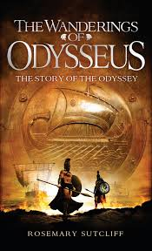
Objectives
To prepare to teach the Reading Reconsidered <Title of Novel> unit through analysis of the novel and supporting materials
To engage in intellectual analysis of literature with your peer learning community
Page 2
Notes:
Estimated Time: 1 min Time:
SAY:
Today we will dedicate some time to analyzing the next book you will be bringing to life for your students.
This time of deep thinking is almost an unspoken requirement of a content-driven curriculum like Reading Reconsidered.
Our goals today are two-fold:
To prepare to teach your next Reading Reconsidered unit through analysis of the novel and supporting materials
To engage in intellectual analysis of literature with your peer learning community
We hope this time leaves you feeling excited and prepared for your next unit. Your engagement in this session will have you feeling more prepared for every lesson you teach in the unit.

Slide 3
Relationships with Books
“Depth of learning requires that students enter into a meaningful relationship with the content itself […] This is most often profoundly facilitated through the modeling of a relationship with content by teachers […] They are living examples for students of what it means to be lifelong learners.”
- Dr. Adeyemi Stembridge, Culturally Responsive Education in the Classroom
Turn and Talk: Choose one word, sentence, or phrase from this quote that resonates with you and share it with a partner.
Page 2
Notes:
Estimated Time: 6 minutes Time:
Note to Facilitator: Slides 3-4 are designed to build buy-in and can be skipped if teachers have participated in a prior Unit Preparation session. All questions posed in slides are included in participant materials. You can choose to modify the cycle of Stop and Jot, Turn and Talk, Share Out as is fitting for your participants.
SAY:
Before we dive into our text, let’s take a moment to step back and think big picture.
As readers, we have all developed our own personal relationships with books we have read. As reading teachers, we want to share that experience with our students.
In the words of Dr. Adeyemi Stembridge… [Read (or ask participants to read) slide and Turn and Talk directions]:“Depth of learning requires that students enter into a meaningful relationship with the content itself […] This is most often profoundly facilitated through the modeling of a relationship with content by teachers […] They are living examples for students of what it means to be lifelong learners.”
DO:
Give participants 2 minutes to Turn and Talk. Pre-call 2 people to share their responses. As participants Turn and Talk, listen for the following key takeaways to surface during the whole-group share.
Take 2-3 minutes to lead a whole-group discussion.
Teachers are always role models. Their passion and love for reading can engage and ignite a similar passion in students.
Students must form a deep relationship with the content they are studying to truly own it. Teachers should model that depth of thinking as well.
We don’t just read for today’s content…we read to create a foundation for tomorrow’s learning. Reading is a powerful way to set students up for success in any academic endeavor they choose.

Slide 4
It’s really hard to teach a curriculum that you didn’t write!
Notes:
Estimated Time: 1 minute Time:
SAY:
We know that for all the benefits of using the Reading Reconsidered curriculum, it’s not without some challenges.
The biggest challenge is that it can be really hard to teach a curriculum that you didn’t write. In some ways it can be like trying to piece together a jigsaw puzzle without knowing what the final picture should look like.
Like a puzzle, the Reading Reconsidered curriculum has many pieces: vocabulary instruction, texts and tools to build background knowledge, Close Reading opportunities, writing tasks, and more.
As a teacher, you’ll grapple with questions like: How does this curriculum speak to my students? How do I choose what to prioritize? How do I manage pacing when the curriculum has so much breadth and depth?
This session is designed to give you the final picture—what the whole puzzle should look like once it is completed. To get to this stage, we will dive deeply into the text and Unit Plan, so we can deliver each lesson with full confidence in our choices around pacing and prioritization.

Slide 5
Agenda
Rigor Through Rich Text
Essential Understandings
Make It Your Own
Page 2
Notes:
Estimated Time: <1 minute Time:
SAY:
Here’s a brief overview of how we will build our understanding of both the Unit Plan and the text we are studying together today. [Read slide.]

Slide 6
First Pages
Read and annotate the opening pages of your text. What do you notice about…
Narrator and Plot
Setting and Tone
Background Knowledge
Turn and Talk: What are you most excited to share with your students from these opening pages? What might be most challenging for students as they read these opening pages?
Page 3
Notes:
Estimated Time: 5 minutes Time:
Note to Facilitator: This slide is animated. After the reading period, you can animate the slide to cue participants for a Turn and Talk of their reading and annotations.
SAY:
As adult readers who are used to analyzing texts, we know that different aspects of a rich text can stand out to us with every read and reread. We’d like to invite you now to reread the opening pages of your novel and note what strikes you about these first pages. What do you notice about:
Narrator and Plot
Setting and Tone
Background Knowledge
You have 4 minutes Silent Solo to reread the first 1-2 pages of the novel. Use the questions on the slide and on page 3 of your packet to guide you but not to limit your analysis—the purpose of this time is to approach the text with an open mind to any new ideas or insights.
DO:
Give participants 4-5 minutes Silent Solo to read and mark up the selection.
Then, give 2 minutes for participants to Turn and Talk: What are you most excited to share with your students from these opening pages? What might be most challenging for students as they read these opening pages?

Slide 7
Rigor Through Rich Text
“The clearest differentiator in reading between students who are college ready and students who are not is the ability to comprehend complex texts.”
- From Reading Between the Lines: What the ACT Reveals about College Readiness
Page 4
Notes:
Estimated Time: 1 minute Time:
Note to Facilitator: You can find the ACT research here: https://www.act.org/content/dam/act/unsecured/documents/reading_summary.pdf
SAY:
The Reading Reconsidered curriculum emphasizes rigor: exposing students to challenging texts to help them become confident, skilled readers.
The American College Testing Service, or ACT, completed a study to determine what the ACT reading scores revealed about college readiness. They looked at student performance in a variety of ways, based on different types of questions and texts. Their ultimate conclusion was, “The clearest differentiator in reading between students who are college ready and students who are not is the ability to comprehend complex texts.”
The Reading Reconsidered curriculum also includes literature that highlights the diversity of the human experience. We know that some of the best, most powerful, and resonant texts out there are some of the hardest to pick up and read independently.

Slide 8
Five* Plagues of the Developing Reader
1. Archaic Text
2. Non-Linear Time Sequence
3. Complexity of Narrator
4. Complexity of Story (Plot and Symbolism)
5. Intentionally Resistant Texts
*Background Knowledge is always a factor!
Page 5
Notes:
Estimated Time: 2 minutes Time:
Note to Facilitator: If teachers have participated in a prior Unit Preparation session, you can just remind them to refresh their memory of the Five Plagues (p. 5 in their packets) and jump to the activity on slide 9.
SAY:
Because the Reading Reconsidered curriculum embraces challenging texts, it’s worth considering some of the different types of challenges that a text may present.
This framework from the Reading Reconsidered team categorizes “Five Plagues” or five characteristics of rigorous texts that can present a challenge for our students. In addition to the five challenges, the asterisk reminds us that a sixth challenge, common to all reading experiences, is that everything we read assumes some degree of background knowledge. When our mastery of that background knowledge is missing or vague, that is another potential barrier to comprehension.
You can find the Five Plagues (along with examples of each) on p. 5 of your packet.

Slide 9
Challenges of the Text
Review the list of the types of Text Complexity to answer these questions:
Which of the Five* Plagues make it challenging to teach <Title of Book>?
Are there other challenging aspects of the text that are not part of the Five* Plagues?
If you’ve taught this text before, note some actual struggles your students faced.
Pages 5-6
Notes:
Estimated Time: 7 minutes Time:
Note to Facilitator: Plan out your own responses based on <Title of Book>, to ensure you can prompt participants if necessary. If there are teachers who have already taught the curriculum or text, this might be an opportunity to honor their work by asking them to speak to some actual challenges that their students faced during the share out.
SAY:
Let’s brainstorm some initial challenges that we anticipate our students will encounter in <Title of Book>.
DO:
Give participants 2 minutes Silent Solo to read over the types of Text Complexity (the Five Plagues) and to use that lens to list challenges found in <Title of Book>.
SAY:
(After 1 minute has passed) If you have not already, start to list which of the Five Plagues are present in <Title of Book>.
Once you have moved through each of the Five Plagues, continue to list additional challenges that <Title of Book> might present for your students. Include specific references to details that support your thinking.
DO:
Give participants 3-4 minutes to share out challenges that relate to the Five Plagues, then share out additional challenges.
Use the Five Plagues to guide participant responses.
Remember that most first-person narratives have “complex narrators” because the narrators often have some sort of “blind spot”—they may not be deliberately leading a reader astray, but there is usually some knowledge about themselves or others that they do not learn until the conclusion of the book.
Remember that texts which include symbolism, metaphors, allusions and other instances of figurative language can be complex and resistant to students who are just developing analytical skills and more abstract reasoning.
Remember that a lack of background knowledge can derail a student’s reading experience. We should be aware of the places in this text that assume a particular historical or cultural knowledge, knowing that the unit materials will support teachers in sharing necessary knowledge with students (through the Knowledge Organizer, the embedded texts, and the embellishments).
Other challenges can arise when parts of the text deal with potentially traumatic situations or introduce more adult-facing themes, depending on the age and maturity level of your students.

Slide 10
Agenda
Rigor Through Rich Text
Essential Understandings
Make It Your Own
Notes:
Estimated Time: <1 minute Time:
SAY:
Now we’ll begin to look at the unit plan itself. The first component of the unit plan that we’ll engage with today are the Essential Understandings.

Slide 11
Essential Understandings: Definition
An Essential Understanding is an idea expressed in 1-3 sentences that captures a concept about life, literature, or history that you want your students to remember as a result of reading this text in your class.
Page 7
Notes:
Estimated Time: 1 minute Time:
Note to Facilitator: If your teachers have participated in the Unit Preparation Session enough that they are familiar with the definition and purpose of Essential Understandings, you can skip directly to slide #12.
SAY:
Essential Understandings are like the blueprints or the design plan for the unit—they are the ideas that each lesson is built around.
In the Reading Reconsidered curriculum, an Essential Understanding is an idea expressed in 1-3 sentences that captures a concept about life, literature, or history that students should remember as a result of reading this text.
Essential Understandings are included on the first page of each unit plan
We’re beginning our work in the unit plan with these Essential Understandings because they help to guide us through the unit. These are the ideas that help tie the many strands of the unit together and are the central themes that should emerge over the course of studying the novel. They are reflected in the Knowledge Organizer and are useful guides when making decisions around pacing and prioritization.

Slide 12
Essential Understandings
Consider these three categories. What ideas and concepts in these three categories do you want your students to remember about <Title of Book>?
Types of Essential Understandings
Literary | genre, author’s craft, diction, literary elements
Thematic | larger life lessons or ideas about the human experience
Contextual | relevant historical, social, or cultural knowledge
Page 7
Notes:
Estimated Time: 2 minutes Time:
Note to Facilitator: Plan out your own responses based on <Title of Book>, using the question below. We have included examples below (from Esperanza Rising, brown girl dreaming, and Animal Farm) to help you get started. You may want to swap out these examples for examples either from the upcoming unit or from past units taught at your school to make them as familiar as possible for the participants.
SAY:
Let’s dive into <Title of Book>.
Stop and Jot: Thinking about these three categories of Essential Understandings—Literal, Thematic, and Contextual—what are some ideas and concepts within these categories that you want your students to remember about <Title of Book>?
DO:
Give participants 90 seconds to jot down their thoughts, Silent Solo.
EXAMPLES:
Note to Facilitator: Not every unit's Essential Understanding will tick every box, and sometimes the Essential Understandings will blend two of the types—these are guidelines and not strict requirements.
Literary Essential Understandings:
“Pam Munoz Ryan uses the plants of the earth and harvest seasons to communicate symbolically about the characters in the book.” (Esperanza Rising, Grade 5)
“Poetry is a different type of writing than prose, so some of our vocabulary and processes as readers change when we read poems.” (brown girl dreaming, Grade 6)
“Fable, allegory, and satire are genres that permit writers to indirectly share a political or moral message or to criticize hypocrisies and injustices.” (Animal Farm, Grade 8)
Thematic Essential Understandings:
“Experience of grief and adversity can shape an individual’s coming of age.” (Esperanza Rising, Grade 5)
“People are complex; their young life, experiences, and family history shape their world view as they grow.” (brown girl dreaming, Grade 6)
“Language is inherently political and can be weaponized. While language can be used to motivate and inspire, it can also be used to manipulate and oppress.” (Animal Farm, Grade 8)
Contextual Essential Understandings:
“Systems of class and caste have historically shaped the experience and interactions of people in both Mexico and the United States.” (Esperanza Rising, Grade 5)
“People are complex; their young life, experiences, and family history shape their world view as they grow.” (brown girl dreaming, Grade 6)
“Communism was born out of the shortcomings of capitalism and monarchy, and it promised its participants equality. However, due to hypocrisies among Communist leadership, people living and working in Communist countries did not receive the equality they were promised.” (Animal Farm, Grade 8)

Slide 13
Essential Understandings: Make Them Yours
Compare the Essential Understandings in the unit plan with the takeaways you wrote.
How do these Essential Understandings reflect your thinking about the book?
How do these Essential Understandings push your thinking?
Page 8
Notes:
Estimated Time: 8 minutes Time:
SAY:
Now we will spend some time “sparring” with the Essential Understandings of the unit.
Compare the Essential Understandings in the unit plan with the takeaways you wrote.
How do these Essential Understandings reflect your thinking about the book?
How do these Essential Understandings push your thinking?
DO:
Give participants 5 minutes Silent Solo to spar with the Essential Understandings.
After 5 minutes have passed, give participants 2 minutes to Turn and Talk to share their discoveries.

Slide 14
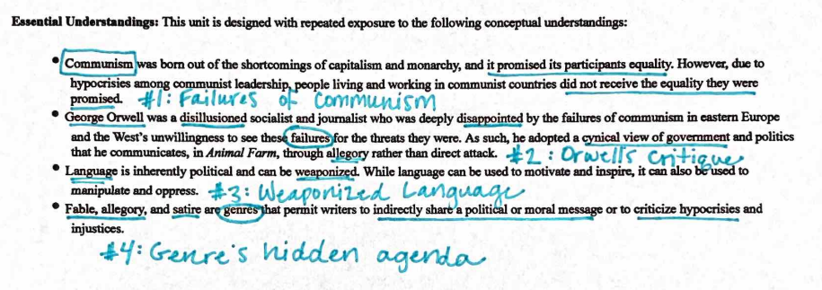
Essential Understandings: Make Them Yours
Turn and Task: Jot a sticky word or phrase to use to refer to each Essential Understanding in your unit plan.
Page 8
Notes:
Estimated Time: 6 minutes Time:
Notes to Facilitator:
This slide is animated. Click to animate the “Turn and Task” directions. The purpose of this activity is to make each Essential Understanding a bit more portable. As teachers start to make these Key Understandings their own, they will begin to see that there is a “through-line” in the unit—that these Essential Understandings are woven throughout many of the daily lessons and individual questions. This allows students opportunities to revisit the ideas again and again, and teachers can better prioritize the exact components of the lessons that will drive students toward the Essential Understandings of the unit.
SAY:
As we move forward, we will see that these Essential Understandings play a key role in almost all of the daily lessons that you teach. One thing to do to keep these ideas alive for yourself is to create a sticky word or phrase to refer to each Essential Understanding from the unit plan.
In this example, you’ll see some “sticky phrases” a teacher might use to refer to the Essential Understandings in the Animal Farm unit.
It’s important that these sticky words capture the main idea of each Essential Understanding as this can help make them easier to remember and recognize as you move through the daily lessons and specific questions. Of course, there are many “right answers” that accomplish this task. [Animate slide.]
DO:
Give participants 4 minutes to work together to create a “sticky” word or phrase that captures the essence of each of the Essential Understandings from the <Title of Book>Unit Plan.
Read over the participants’ work so you can Cold Call pairs whose words/phrases would benefit the group.

Slide 15
Essential Understandings: Make Them Yours
Turn and Task: Jot a sticky word or phrase to use to refer to each Essential Understanding in your unit plan.
Page 8
Notes:
Estimated Time: 2 minutes Time:
Note to Facilitator: You should prepare your own sticky word or phrase in advance so that you are prepared to guide participants to capture the heart of the Essential Understanding in a brief word or phrase. Your sticky words don’t have to match each other’s, as long as they capture the essence of the Essential Understandings. However, if you are in a school where several teachers are teaching the same units, you may want to use the same phrase so that you have common language to use throughout the unit.
SAY:
Could we have a volunteer share the sticky word or phrase that their group decided on for the first Essential Understanding?
DO:
Continue to share out 1-2 sticky words or phrases for the rest of the Essential Understandings.

Slide 16
Essential Understandings: Make Them Yours
Reflection: Which Essential Understandings do you think will be most accessible or interesting to your students? Which may be more challenging to access?
Page 8
Notes:
Estimated Time: 2 minutes Time:
SAY:
Let’s think about these Essential Understandings in the context of your students: Which Essential Understandings do you think will be most accessible or interesting to your students? Which may be more challenging to access?
DO:
Give participants a minute to jot their reflection on page 8 of the packet.

Slide 17
First Pages
Review your annotations on the first pages. Where do you see connections to the unit’s Essential Understandings?
Page 9
Notes:
Estimated Time: 6 minutes Time:
SAY:
Let’s look back at our initial reading of the first pages of <Title of Book> to reorient ourselves to our upcoming unit. Review your annotations and consider:
Where do you see connections to the unit’s Essential Understandings?
DO:
Give participants 1 minute Silent Solo to jot some thoughts about the connections they see.
Give participants 2 minutes to Turn and Talk to share their answers.
Invite 2-3 pairs to share whole group.

Slide 18
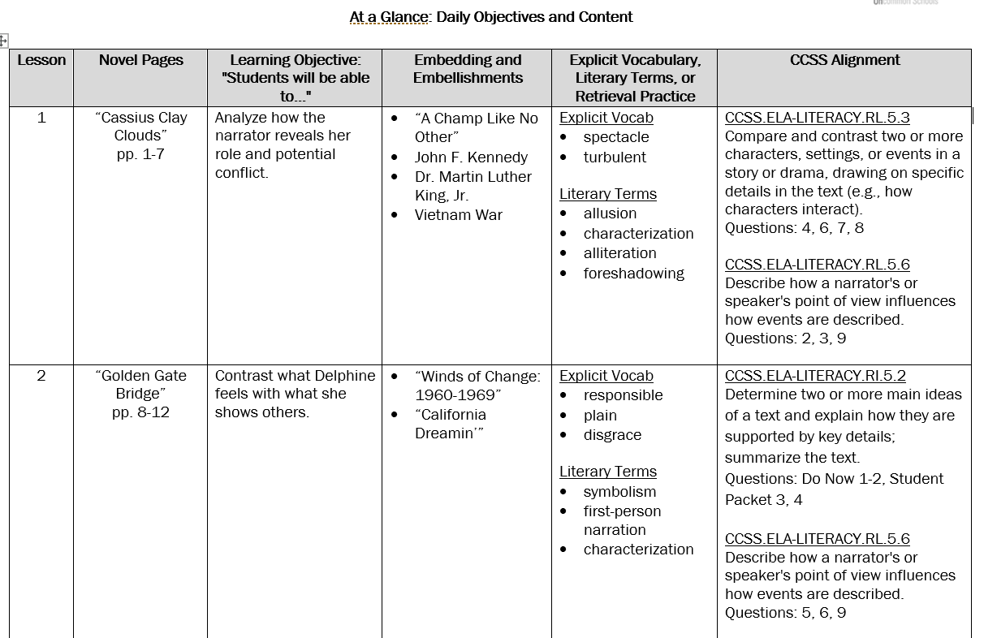
Essential Understandings: At a Glance
Turn and Task: In your unit plan, turn to “At a Glance: Daily Objectives and Content.” Choose 1-2 lessons you think will be particularly important for developing each Essential Understanding.
Page 9
Notes:
Estimated Time: 7 minutes Time:
Note to Facilitator: The Reading Reconsidered Curriculum has a unique approach to objectives—they are text-driven, not skills driven. Therefore, labeling objectives with the corresponding Essential Understandings won’t always be obvious, and some may not seem (on the surface) to correlate with a particular Essential Understanding. You may want to work through some of the first few days on your own as you prepare for the session, so that you can direct participants to more straightforward connections if necessary.
SAY:
This next activity illustrates how the Essential Understandings drive each unit.
Together, we have begun to internalize the Essential Understandings for <Title of Book>. However, these understandings are teacher-facing: that is, you as teachers see the Unit Plan; students do not. Instead, students will build these understandings over time as they engage in the daily lessons.
A few pages into the <Title of Book> Unit Plan, you will see the “At a Glance” section, which lays out the daily objectives and content of each lesson.
Skim through the At a Glance section and try to match 1-2 lessons to each of the Essential Understandings.
Just a hint: For each lesson, reading the Learning Objective can help you decide which of the Essential Understandings is prioritized in that lesson. Noting information in the other columns, such as Embedding and Embellishments or Literary Terms, can also help you make your decisions.
DO:
Give participants 3-4 minutes to get through as many objectives as they are able.
Ask for a volunteer to explain a lesson they selected and the Essential Understanding it reinforces.

Slide 19
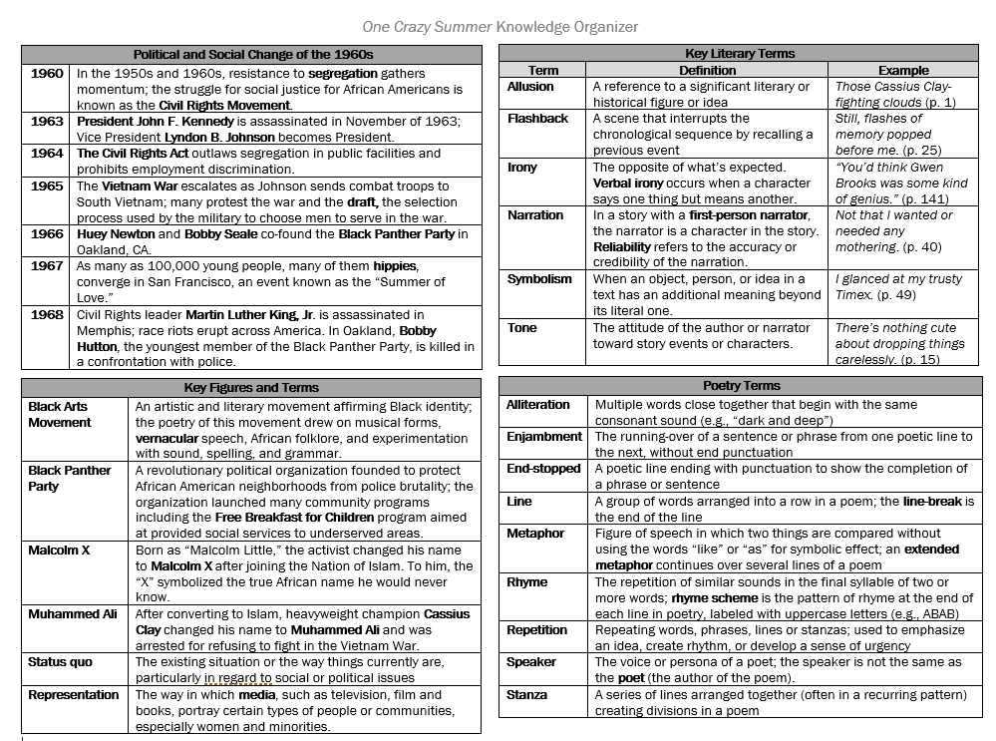
The Knowledge Organizer
The Knowledge Organizer contains the crucial information that students will need to fully grasp the Essential Understandings of this text – and to build a broad base of knowledge that will support them in their future readings.
Page 10
Notes:
Estimated Time: 1 minute Time:
SAY:
In your review of the unit plan, you likely noticed that the embeddings and embellishments in each day’s lesson help to build student knowledge and enable them to access the text in richer, deeper ways.
In order to help students grapple with the Essential Understandings of the unit and engage deeply with the text, we must ensure they (and we!) build adequate background knowledge.
The Knowledge Organizer is a one-page document that captures the high-priority knowledge that students need to know in order to understand this text.
Read Slide: “The Knowledge Organizer contains the crucial information that students will need to fully grasp the Essential Understandings of this text – and to build a broad base of knowledge that will support them in their future reading.

Slide 20
The Knowledge Organizer
Review the Knowledge Organizer in your unit plan.
Where do you see connections to the Essential Understandings?
What knowledge might your students be familiar with already? What might be unfamiliar?
Page 10
Notes:
Estimated Time: 2 minutes Time:
SAY:
The Knowledge Organizer is a document that you will share with your students, and it is a resource that will help them engage with facts that will build their knowledge of the unit and facilitate their grasp of the Essential Understandings.
Here are a few questions to interact with the Knowledge Organizer so that you will be ready to use it to support your students.
Review the Knowledge Organizer in your unit plan.
Where do you see connections to the Essential Understandings?
What knowledge might your students be familiar with already? What might be unfamiliar?
DO:
Give participants 1-2 minutes to review their Knowledge Organizer.

Slide 21
Essential Understandings: Takeaways
What takeaways do you have from our examination of Essential Understandings?
Page 10
Notes:
Estimated Time: 1 minute Time:
Note to Facilitator: In the debrief conversation, participants may be excited about the Essential Understandings and may generate ideas about how to make them evident to students throughout the unit. For example, they may want to post the Essential Understandings in the classroom or share them with students at the beginning of the unit. As a facilitator, you should encourage this enthusiasm but remind teachers that these are ultimately teacher-facing understandings. Students may not be able to access Essential Understandings initially because the point of the unit is to build up their understanding to these takeaways.
SAY:
Take a moment to Stop and Jot – what takeaways do you have from our examination of Essential Understandings?
DO:
You might have participants respond to this question Silent Solo or through a Turn and Talk.
Monitor the responses and ask a few participants to share out, strategically leading up to the stamp which is articulated on the next slide.

Slide 22
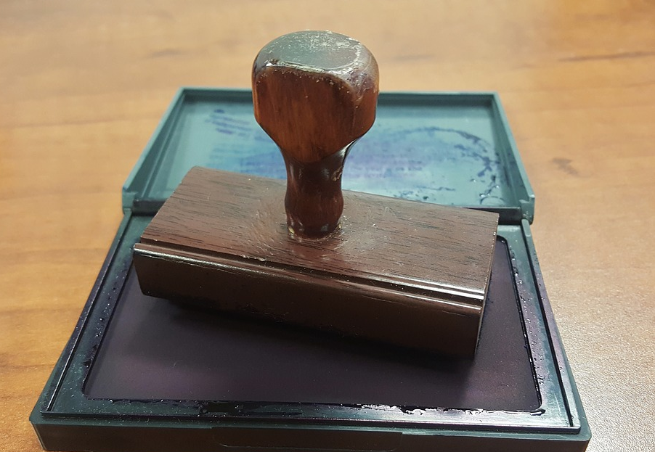
Essential Understandings: Stamp
Essential Understandings help teachers drive student learning. They guide the specific daily decisions teachers make: adjusting for pacing, facilitating conversation, breaking down key questions, stamping important takeaways in discussion, and supporting student writing.
Page 10
Notes:
Estimated Time: 1 minute Time:
SAY:
Our reflection has led us to articulate this understanding already, but let’s stamp it to make sure we are all on the same page.
DO:
Read the stamp from the slide: “Essential Understandings help teachers drive student learning. They guide the specific decisions teachers make: adjusting for pacing, facilitating conversation, breaking down key questions, stamping important takeaways in discussion, and supporting student writing.”
Give participants a moment to jot down the stamp in their materials.

Slide 23
Agenda
Rigor Through Rich Text
Essential Understandings
Make It Your Own
Notes:
Estimated Time: <1 minute Time:
SAY:
We’ll wrap up our time today by returning to the central purpose of why we prepare so deeply, and why we teach literature: to connect our students to the texts we share.

Slide 24
Connecting Students to Text
“Brilliant teachers understand that an excellent lesson exists specifically in the context of the student audience that receives it […] In order to be successful, teachers must be attentive to these varied and changing contexts. Therefore, planning is the space where teachers design the moments in which they will leverage their relationships with students and facilitate opportunities for kiddos to make powerful connections between their social, cultural, and academic identities.” (p. 119)
- Dr. Adeyemi Stembridge, Culturally Responsive Education in the Classroom
Stop and Jot: How might studying the book deeply prepare you to facilitate opportunities for connection?
Page 11
Notes:
Estimated Time: 3 minutes Time:
SAY:
The Reading Reconsidered Curriculum is built on the belief that, as Dr. Adeyemi Stembridge says, “An excellent lesson exists specially in the context of the student audience that receives it.”
[Ask participants to independently read the rest of the quote and the Stop and Jot prompt.]
DO:
Give participants 2 minutes to Stop and Jot their thoughts.
Call on 1-2 participants to share out their insights
If necessary, share the following insights:
While the plans and student materials are already written, as teachers, we must be attentive and responsive to our students, facilitating opportunities for the learners in our classes to make powerful connections between literature and their own lives and identities.
In order to do the planning described in this quote, we must have a deep knowledge and thorough understanding of both the book and its major themes/areas of knowledge. Owning that knowledge will amplify our ability to make connections to our students and to their identities.

Slide 25
Connecting Students to Text
The Text
Engagement and Connection
Your Students
Key Idea: Engagement and connection with text come when teachers have deep knowledge of both the text and their students.
Page 11
Notes:
Estimated Time: 1 minute Time:
SAY:
Dr. Stembridge makes the point that curriculum is a suggested pathway or a set of tools that requires the teacher’s expertise to make it meaningful to students.
Similarly, your knowledge of the text must blend with your knowledge of your students to truly foster engagement and connection with the material.
Stamp by reading the key idea: “Engagement and connection with text come when teachers have deep knowledge of both the text and their students.”

Slide 26
Make It Your Own
Proactive Questions (Before teaching the unit) | Responsive Questions (During/after teaching each lesson)
Prior Knowledge What books have my students already read? What literary terms have we studied? What themes or knowledge may be familiar? What may be less familiar? Student Needs Which of my students may need supplemental materials or additional support? Which of my students are ready for additional challenges or increased autonomy? | What ideas are resonating most with students? What themes are students eager to discuss and write about? Which Essential Understandings are they accessing? Which Essential Understandings are most challenging? What do students need additional practice with?
Page 12
Notes:
Estimated Time: 3 minutes Time:
SAY:
Our knowledge of our students allows us to foster connection and engagement with the text by considering the specific context of our students.
Thinking through questions like these can help us make decisions about what to prioritize or adapt.
First, there are questions that you can proactively ask yourself about the knowledge your students already bring to the table, or the specific needs that will help you better support your group of students. You likely already know the answers to these questions before launching <Title of Book>.
Then, there are responsive questions, or those that you can ask yourself after beginning the unit, as you gauge students’ excitement and gather data about students’ comprehension.
DO:
Give participants about 90 seconds to read through the questions on the slide.

Slide 27
Make It Your Own
Reflect: How might your answers to these questions impact your preparation?
Page 12
Notes:
Estimated Time: 2 minutes Time:
SAY:
Take about 90 seconds to reflect on this question: How might your answers to these proactive and responsive questions impact your preparation? Think about some of the specific components of lesson plans or the Knowledge Organizers to help you respond.
DO:
Give 90 seconds to jot down ideas.
Ask for 2-3 volunteers to share out.

Slide 28
Make It Your Own
Expedite (What can you deemphasize or drop for pacing?) | Add (Where might you supplement or devote more time?)
Deprioritize material when students have solidified knowledge (e.g., drop a Retrieval Practice question, change Means of Participation, move to homework) Shorten or drop discussion if students are readily grasping the Essential Understanding and key ideas | Respond to students’ engagement with a particular topic by extending those discussions or adding homework opportunities Add additional writing, research, or project-based learning to support students’ connection to unit Add additional Retrieval Practice to help students solidify knowledge from KO
Page 13
Notes:
Estimated Time: 2 minutes Time:
SAY:
After you have used your knowledge of your students to answer the questions, you’ll have a better sense of how to tailor the lessons to your individual students.
Tailoring the lessons generally involves either trimming something to expedite the lesson or adding something to better support or engage your students.
DO:
Read the slide to participants:
To expedite, deemphasize or drop, you might:
Deprioritize material students have solidified knowledge on (e.g., drop a Retrieval Practice question, change Means of Participation, move to homework)
Shorten or drop discussion if students are readily grasping the Essential Understanding and key ideas
To add, supplement, or extend, you might
Respond to students’ engagement in a particular topic by extending those discussions or adding homework opportunities
Add additional writing, research, or project-based learning to support students’ connection to the unit
Add additional Retrieval Practice to help students solidify knowledge from the Knowledge Organizer

Slide 29
Planning and Prioritization
Review the first Lesson Plan and Student Packet of your next unit and consider:
Where do you see connections to the unit’s Essential Understandings and to your reading of the first pages?
Using this knowledge of the unit and knowledge of your students, what are some decisions you might make in preparing for and teaching Lesson 1?
Page 13
Notes:
Estimated Time: 10 minutes Time:
Note to Facilitator: As with each of these exercises, we strongly suggest that, as facilitator, you complete some of the Day 1 Lesson Plan/Student Packet review independently before the start of the workshop so you are prepared to respond nimbly and accurately to the points raised by participants. Note that participants will not finish the task in the 7-minute time frame; this is just time to start a deep dive into Day 1’s plan—a preview of what they will do to prepare every lesson.
SAY:
The purpose of diving deep into the Essential Understandings, the Knowledge Organizer, and this initial Close Read are to help you make decisions about how to plan and prioritize this material for your students. As a final task today, we’ll begin the daily planning process with a couple of questions you might use as you prepare each lesson.
DO:
Give participants about 7 minutes to review the first Lesson Plan and Student Packet and annotate or take notes to respond to the following:
Where do you see connections to the unit’s Essential Understandings and to your reading of these first pages?
Using this knowledge of the unit and knowledge of your students, what are some decisions you might make in Lesson 1?
Ask participants to share out a few of the choices or decisions they would make for Lesson 1 of the unit.

Slide 30
Final Takeaways
Based on our work today, what is one new idea or new perspective about the book that you are excited to share with your students?
Page 13
Notes:
Estimated Time: 3 minutes Time:
SAY:
We’ll wrap up our time today by returning to the central purpose of why we prepare so deeply to teach these units, and why we teach literature: to connect our students to the texts we share.
Grounding yourself in the Essential Understandings, becoming familiar with the Knowledge Organizer, rereading sections of text, and making the plans your own set you up to dive in and teach. The pieces of the puzzle now fit together.
Let’s spend our final moments reflecting on what we’ve learned today:
Based on our work today, what is one new idea or new perspective about the book that you are excited to share with your students?
Possible back-pocket question for veteran teachers and/or early finishers: Based on your review of our approach or lenses, what are some other aspects of the book you’re curious to know more about or study more deeply?
DO:
Take 90 seconds Silent Solo to answer
Ask for 2-3 volunteers to share out.

