Slide 1
Knowledge Building Clip Library

Slide 2
Table of Contents
Embedded Nonfiction: Reading
Supporting comprehension during nonfiction reading
Embedded Nonfiction: Questioning
Checking for understanding before analysis
Knowledge Feeding
Preplanned pieces of relevant knowledge
Retrieval Practice
Encoding knowledge in long-term memory
Retrieval Practice: During Reading Cycles
Activating relevant knowledge in the moment

Slide 3
Embedded Nonfiction: Reading Knowledge Building Clip Library

Slide 4
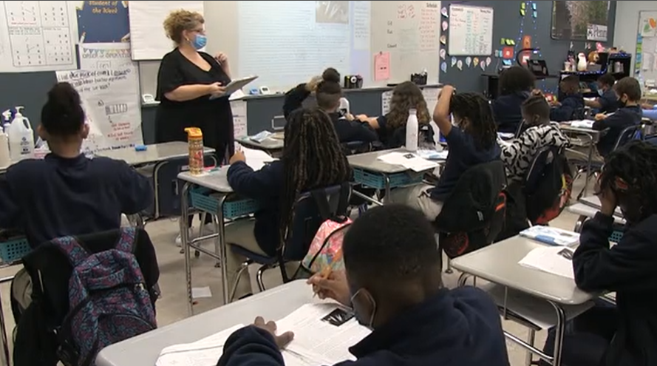
Kristin Curran
How does Kristin support her students in building knowledge through embedded nonfiction?
Notes:
Clip Title: Reading.ReadAloud.EmbeddingNonFiction.GR5.Curran.'Nazi violence against Jews.'Clip3360
Context:
In this clip, Kristin Curran leads Lesson 4 from the unit for Number the Stars, written by Lois Lowry, with a 5th grade class in Troy, NY.
Students have read the first two chapters of the novel and are now using a nonfiction text to build knowledge about the Holocaust.
Alternative Framing Questions:
What preparation did Kristin need to do in order to support students during reading?
What is effective about Kristin’s prompting and questioning during reading?

Slide 5
Kristin Curran
Clear system for annotations
Slow, expressive reading
Vocabulary support
Checks for understanding during reading
Notes:
Notes on reading embedded nonfiction:
Clear system for annotations: Kristin gives clear directions for annotations so that students have a concrete area of focus and she can observe their comprehension and engagement during reading. Moreover, asking students to annotate information that “connects to your background knowledge” is the first step in linking new knowledge with existing knowledge and moving it to long-term memory.
Slow, expressive reading: Kristin chooses to read aloud this denser nonfiction text so that she can read slowly and expressively, allowing students plenty of processing time.
Vocabulary support: Kristin supports students with potentially challenging vocabulary in several different ways. She reminds them of helpful text features, like footnoted definitions, she drops in quick preplanned definitions, and she asks students to provide definitions when she thinks some of them might have appropriate word knowledge.
Checks for understanding during reading: Kristin doesn’t wait until the end of the text to check students’ comprehension. Instead, she asks quick, preplanned text-based questions to assess any misunderstanding and ensure accurate understanding before jumping back into the reading.
You might also consider this clip for:
Read Aloud
Implicit Vocabulary
Lesson Preparation
FAQs:
Are Kristin’s annotation tasks the same for every nonfiction text?
Kristin does use a consistent system of nonfiction annotation, with occasional adjustments depending on the demands and purpose of the text. While she gives students three areas of focus in this clip (new information, something that makes you reflect, something that connects to your background knowledge), you might start with one clear task as you introduce annotations in your classroom and students build familiarity with your system.
How does Kristin decide when to ask comprehension questions?
Kristin uses her knowledge of her students (what might be challenging/what do they already know) and the unit (what are the most important pieces of information in this text) to make decisions about when and how to ask comprehension questions during reading. It is important not to interrupt the flow of the text with too many questions, so Kristin’s prioritization and preplanning are key to making this reading effective.

Slide 6
Embedded Nonfiction: Questioning Knowledge Building Clip Library

Slide 7
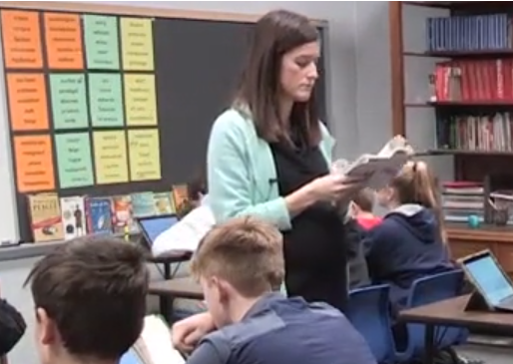
Emily DiMatteo
What makes Emily’s questioning in this clip effective?
Notes:
Clip Title: RC.NonFiction.GR8.DiMatteo.'Manipulate.'Clip3053
Context:
In this clip, Emily DiMatteo leads Lesson 14 from the unit for Animal Farm, by George Orwell, with an 8th grade class in Cincinnati, OH.
Students are reading an embedded nonfiction article on scapegoating and memory manipulation. They will apply this knowledge to analyze a scene in the novel in which one character tries to manipulate the memories of other characters.
Alternative Framing Questions:
How does Emily invest students in the purpose of this nonfiction text?
How does Emily nurture a knowledge-driven culture of reading?

Slide 8
Emily DiMatteo
Sets a purpose for reading
Establishes meaning through text-based questions
Reestablishes relevant plot details
Stretch It/Right is Right
Overlapping annotation task
Notes:
Notes on Questioning during Embedded Nonfiction:
Sets a purpose for reading: Before asking students to read the text, Emily anchors the nonfiction in the context of the narrative and previews the ways in which this knowledge will be relevant in their analysis of the novel (and in their own lives!). This makes students more engaged and invested in the reading.
Establishes meaning through text-based questions: After reading, Emily checks for understanding using factual, text-based questions. This allows here to resolve any misconceptions and stamp accurate understandings before asking students to move to deeper analysis.
Reestablishes relevant plot details: In order to successfully analyze the text, students must have an accurate recollection of relevant plot details from the novel. Emily asks questions that require students to retrieve their knowledge of the events of the text before they apply the new knowledge they gained from the nonfiction.
Stretch It/Right is Right: Throughout her factual questioning about both the nonfiction and the novel, Emily holds out for precise, all-the-way-right answers by using Stretch It and Right is Right. This ensures that students can begin analysis with accurate and complete banks of knowledge.
Overlapping annotation task: When students return to the novel, Emily asks them to start to apply their new knowledge in their analysis of the text. Her annotation task (look for examples of scapegoating) gives students a concrete, knowledge-based entry point to the novel.
You might also consider this clip for:
Stretch It/Right is Right
Charting
Establish vs. Analyze Meaning (Text-Based Questions)
FAQs for this clip:
What is Emily writing as she facilitates discussion?
Emily and her students have the embedded nonfiction text on tablet computers, and Emily projects her screen at the front of the room. During discussion, Emily can annotate and chart in real time to capture the key takeaways of discussion. This gives students a model for their own notes and provides a visual anchor for reference during discussion. If you do not have access to a tablet, similar charting is possible using a projector and/or chart paper/white board.

Slide 9
Knowledge Feeding Knowledge Building Clip Library

Slide 10
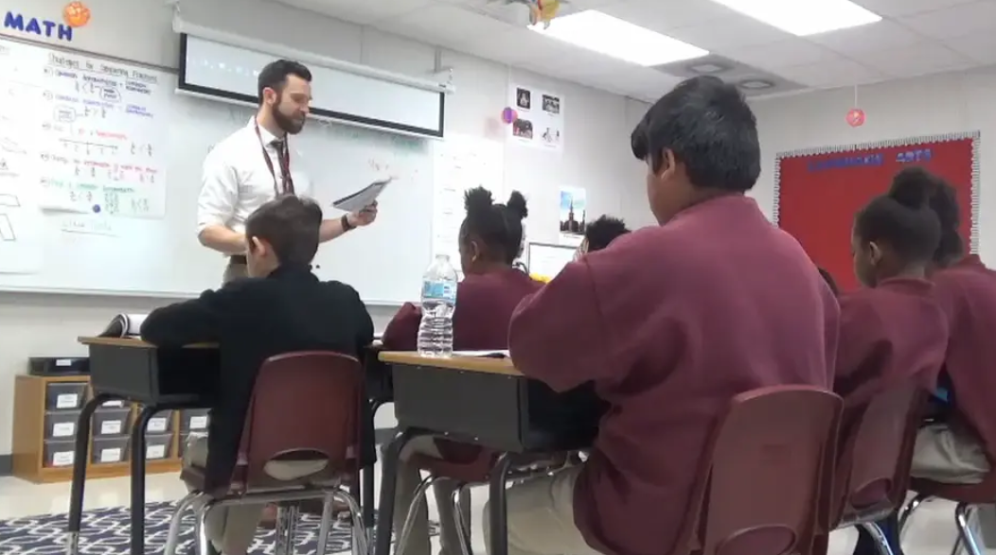
Knowledge Feeding Montage
What is effective about the ways in which these teachers drop in knowledge?
Notes:
Clip Title: EA.Ratio.GRM.MultipleTeachers.'Knowledge feeding montage'Clip3045
Context:
In this clip, Doug Lemov and Charlie Friedman read from Esperanza Rising, and Christine Torres teaches from the Number the Stars unit.
Alternative Framing Questions:
What did these teachers need to do to prepare to drop in knowledge?

Slide 11
Knowledge Feeding Montage
Quick and efficient
Preplanned and relevant
Student interaction
Reduces barriers to comprehension
Notes:
Notes on Everybody Writes
Reduces barriers to comprehension: Each teacher has identified a word or concept that could be distracting and confusing for students, thus interrupting their comprehension. By quickly dropping in relevant knowledge, students can focus on the text through a more nuanced and knowledgeable lens.
Preplanned and relevant: These moments of knowledge feeding are preplanned; teachers have identified pieces of relevant knowledge and scripted precise explanations. The explanation is appropriate to the grade and context; for example, Charlie does not go into great detail about the author and history of Don Quixote, he simply describes it as a “book about a long journey.” Esperanza, the main character in the novel, is herself going on a long journey, so Charlie helps students activate that connection and deepen comprehension. Christine has even prepared an image to quickly activate students’ understanding.
Quick and efficient: Each teacher quickly provides a student-friendly piece of information, then jumps back into the text. This preserves the flow of the narrative and keeps pacing engaging.
Student interaction: When relevant, students interact with the term or knowledge, whether by pronouncing the word, making an annotation in their text, or connecting to something they know (“you may have seen older people carrying handkerchiefs like these”). This makes the knowledge more durable.

Slide 12
Retrieval Practice Knowledge Building Clip Library

Slide 13
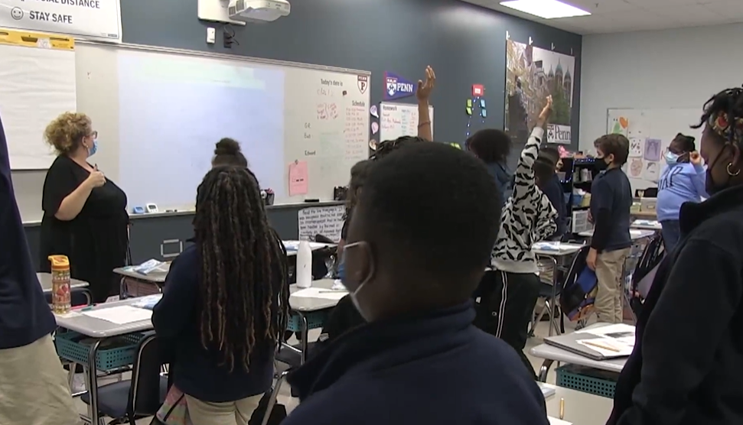
Kristin Curran
What makes Kristin’s Retrieval Practice effective?
Notes:
Clip Title: RetrievalPractice.GR5.Curran.'Germany occupied Denmark.'Clip3358
Context:
In this clip, Kristin Curran leads Retrieval Practice from Lesson 4 from the unit for Number the Stars, by Lois Lowry, with a 5th grade class in Troy, NY.
This is the first Retrieval Practice of the unit.
Alternative Framing Questions:
How does Kristin maximize engagement and keep pacing efficient?

Slide 14
Kristin Curran
Various Means of Participation
Strong pacing
Right is Right/Stretch It
Vocabulary is knowledge
Prioritizes key questions
Notes:
Notes on Retrieval Practice:
Various Means of Participation: Students answer questions through Turn and Talk, by raising their hand to volunteer, and through Cold Call. This provides multiple at-bats for each student to keep engagement high and ensure that everyone is doing the thinking.
Strong pacing: The high engagement also creates the illusion of speed. Kristin’s clear systems and efficient language keep momentum strong and help her get through several questions in just 6 minutes.
Right is Right/Stretch It: Kristin holds out for precise answers so that students can encode complete and accurate knowledge into long-term memory. She frequently asks students to build on others’ answers and is prepared with back-pocket questions to ensure depth of thinking.
Vocabulary is knowledge: When relevant, Kristin prompts students to use domain-specific vocabulary to support accurate, sophisticated responses.
Prioritizes key questions: Kristin uses her knowledge of her students and the unit to prioritize key questions in the Retrieval Practice section of the student packet. These questions activate and encode key vocabulary, plot knowledge, and terms from the Knowledge Organizer.
You might also consider this clip for:
Means of Participation
Pacing
FAQs:
Why are Kristin’s students standing?
Kristin’s students stand during Retrieval Practice to get a brief physical break from sitting and to create a “bright line” between Retrieval Practice and other parts of the lesson. You might find it more appropriate for your class to remain seated.

Slide 15
Retrieval Practice: During Reading Cycles Knowledge Building Clip Library

Slide 16
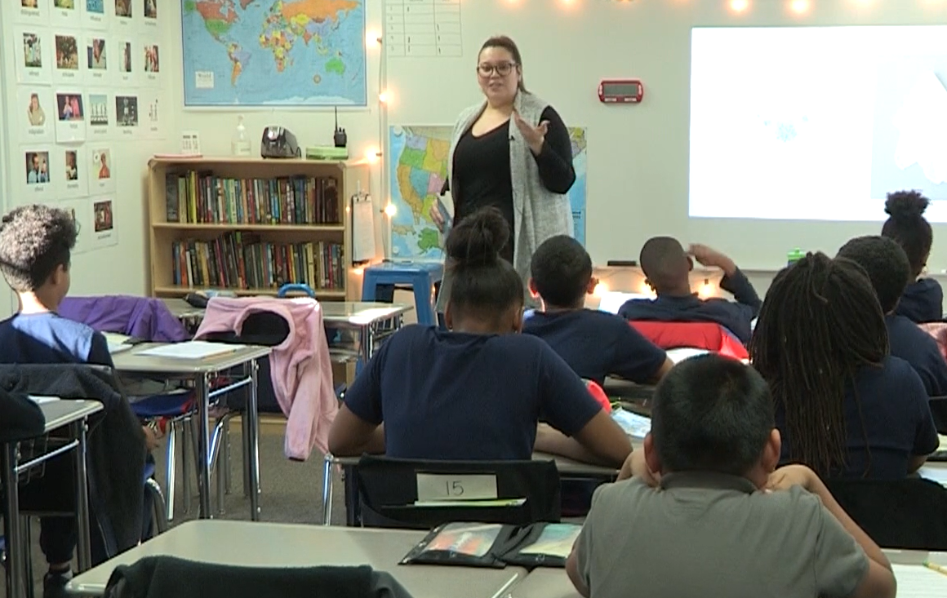
Christine Torres
How does Christine use knowledge to support students’ analysis?
Notes:
Clip Title: RC.RetrievalPractice.GR5.Torres.'Straight towards that wall.'.Clip3019
Context:
In this clip, Christine Torres leads Lesson 14 from the unit for Number the Stars, by Lois Lowry, with a 5th grade class in Springfield, MA.
Students have just finished a cycle of reading and are preparing to answer the question, “Why might Lowry have chosen to end this chapter with a moment of comic relief?” Comic relief is a term on the Knowledge Organizer for the unit.

Slide 17
Christine Torres
Anticipates misunderstanding
Quick, efficient activation
Visual resource
Notes:
Notes on Retrieval during Reading Cycles:
Anticipates misunderstanding: As part of her preparation process, Christine has identified the term “comic relief” as a potential barrier to students’ understanding. She preplans a question to prompt students to retrieve this definition, so they are more likely to have an entry point to begin their analysis.
Quick, efficient activation: Because her question is preplanned, Christine can quickly activate the relevant knowledge and then move smoothly into student analysis.
Visual resource: Christine has an enlarged copy of the Knowledge Organizer on her wall that students can quickly and easily reference the knowledge they need.
You might also consider this clip for:
Lesson Preparation

