Slide 1
Do Now Clip Library

Slide 2
Table of Contents
Classroom Culture
Communicating expectations for routines that norm and build academic habits
Active Observation
Attention to student work before reviewing
Student Engagement
Supports pacing and builds momentum for the lesson

Slide 3
Classroom Culture Do Now Clip Library

Slide 4
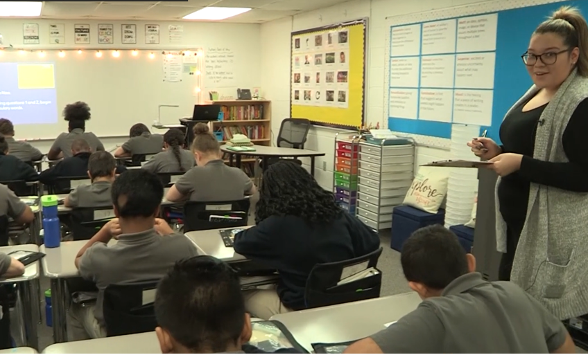
Christine Torres
In what ways does Christine support strong classroom culture during the Do Now?
Notes:
Clip Title: RC.SystemsRoutines.GR5.Torres.'Silently to your seats'.Clip3030
Watch the clip here: [Box link]
Context:
In this clip, Christine Torres leads Lesson 14 from the unit for Number the Stars, written by Lois Lowry, with a 5th grade class in Springfield, MA.
As the clip opens, Christine welcomes her students into class and observes their progress on the Do Now, a nonfiction text that builds background knowledge.
Alternative Framing Questions:
What does Christine do to reinforce her expectations during the Do Now?
What makes this a strong, positive start to Christine’s class?

Slide 5
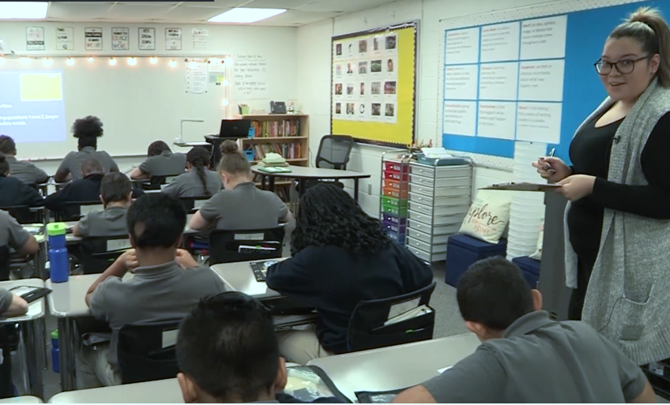
Christine Torres
Immediate attention to culture and community
Positive narration supports pacing
Silent Solo
Attentive circulation
Classroom and materials support expectations
Notes:
Notes on Classroom Culture during the Do Now:
Immediate attention to culture and community: Students are greeted with Christine’s continuous warmth and smile, which welcomes them into a learning community that is caring and supportive. Christine is happy to be with this community of learners.
Positive Narration supports pacing: Christine uses positive narration to reinforce her classroom expectations while students are actively engaged in them. She also narrates a progression of actions (from pencils out, to pencils moving, to silent reading, to answering question 1, to moving to question 2). Her intentional choices of what actions to celebrate convey the pacing she wants students to maintain.
Silent Solo: Once students have settled into their work, Christine supports student working in a calm, quiet environment. She stops for a whispered reminder to an individual student so as not to interrupt the rest of the class; her only words are the pacing reminders.
Attentive circulation: Christine moves around the classroom calmly and predictably, pausing to look around the room and see whether any students might need further support.
Classroom and materials support expectations: Students enter a classroom of predictable systems: the Do Now is in the Student Packet which is already set up on student desks; the directions are projected on the board so Christine needs only one oral reminder. This predictability means students can meet Christine’s expectation that they are immediately engaged and focused on their work, and it gives Christine the ability to observe and give feedback immediately, signaling the importance of students’ intellectual efforts.
You might also consider this clip for:
Systems and Routines
Silent Solo
Classroom Culture
FAQs:
What does this look like in the first week of school?
When Christine first teaches the Do Now routine, she moves more slowly and methodically through each step, and gives more directions throughout. She also gives students smaller, shorter chunks of work and provides quick feedback on their competition of the routine. Over the first few weeks of school, she scales back her “teacher talk” and lengthens work time.
What components are central for an effective start to Christine’s class period?
Christine’s joyful demeanor ensures that she can begin a class with many expectations in place but without these routines seeming harsh or restrictive. She understands that the Do Now is a section of class that sets the stage for the rest of the class period: we will get down to business efficiently, and the business of a reading class is reading and writing. She trusts that her students can work independently, with little interruption from her as they transition from whatever class or activity they came from into their reading community.

Slide 6
Active Observation Do Now Clip Library

Slide 7
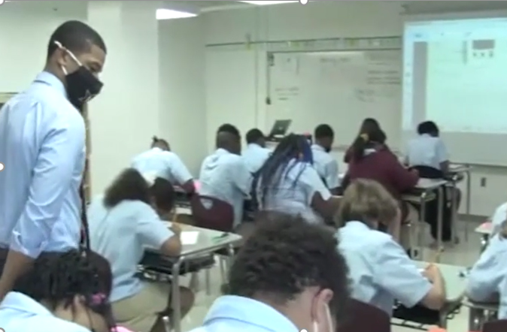
Hasan Clayton
Waiting for final clip code
How does Hasan’s attention to student work support his Do Now review?
Notes:
Clip Title: WAIING FOR FINAL CLIP CODE!!
Watch the clip here: [Box link]
Context:
In this clip, Hasan Clayton leads Lesson 22 from the unit for To Kill A Mockingbird, by Harper Lee, with an 8th-grade class from Nashville Classical Charter School.
During the Do Now, students are close reading a passage of the text that they read together in class the previous day. The questions ask them to paraphrase a line of text and to analyze Harper Lee’s choice of the adjective “real.”
Alternative Framing Questions:
How does Hasan maintain systems and communicate expectations during the Do Now?

Slide 8
Hasan Clayton
Silent Solo
Active Observation
Positive narration
Intentional review
Stamp the knowledge
Notes:
Notes on Active Observation:
Silent Solo: Hasan has installed a norm of Silent Solo, which allows him to collect real-time data from students and gives students a calm, quiet environment for work.
Active Observation: With his exemplar in hand, Hasan pauses at individual students’ desks to collect data. His system of check marks allows him to give feedback without speaking so as not to interrupt students’ independent work and focus. This data also allows him to make intentional choices about which responses to surface during the Do Now review.
Positive Narration: When Hasan does speak, he delivers positive praise to students. Some of the praise is general, maintaining student momentum (“You got this” after a reminder of how much time is remaining). At other times, Hasan offers more precise praise, which values the work of individual students and gently reminds other students of how they might strengthen their own answers (“Love these Knowledge Organizer words that Anthony Walker just used. The word he used was ‘aristocrat.’”; “Love these responses for question 2, telling me specifically why she was crying that second time.”)
Intentional review: Once the review starts, Hasan is prepared to call on individual students to surface strong answers. His knowledge of student responses also allows him to quickly surface more than one potential response (“I also saw other scholars writing things like…”), which makes it more likely that every student will gain some additional understandings during the review. This intentional review also supports pacing.
Stamp the knowledge: Reminding students to add to their responses in green pen (while Hasan adds student answers to the Student Packet projected on the board) ensures that students stamp the knowledge, reinforces the recall of plot elements from the previous discussion, and helps students to activate the knowledge that will make Hasan’s statement of purpose come true: “This tells me we are about to have an excellent class discussion.”
You might also consider this clip for:
Positive Narration
Pacing
FAQs for this clip:
What is Hasan talking about when he says, “You guys are arrogant”?
Hasan is reciting a correct response to the paraphrase question, said from the point of view of the character in the text (Mayella Ewell). He is not speaking directly to students.
Why does Hasan shift registers during the lesson?
Hasan shifts his register from low (individual interactions with students) to medium (positive narration during Silent Solo) to high (“Loud” during DN review). Hasan’s tone is loudest when asking students to be louder, as he models for them the volume he expects (and the volume he needs while students are masked!). While his “louds” are striking, he makes sure to praise and honor each students’ work after he asks them to speak louder. A final note: Hasan has very strong relationships with his students, who are familiar with his teaching style. Different teachers have different tones, and you might choose to use different volumes or registers with your students, always being mindful and aware of the impact that teacher tone and registers have on students.

Slide 9
Student Engagement Do Now Clip Library

Slide 10
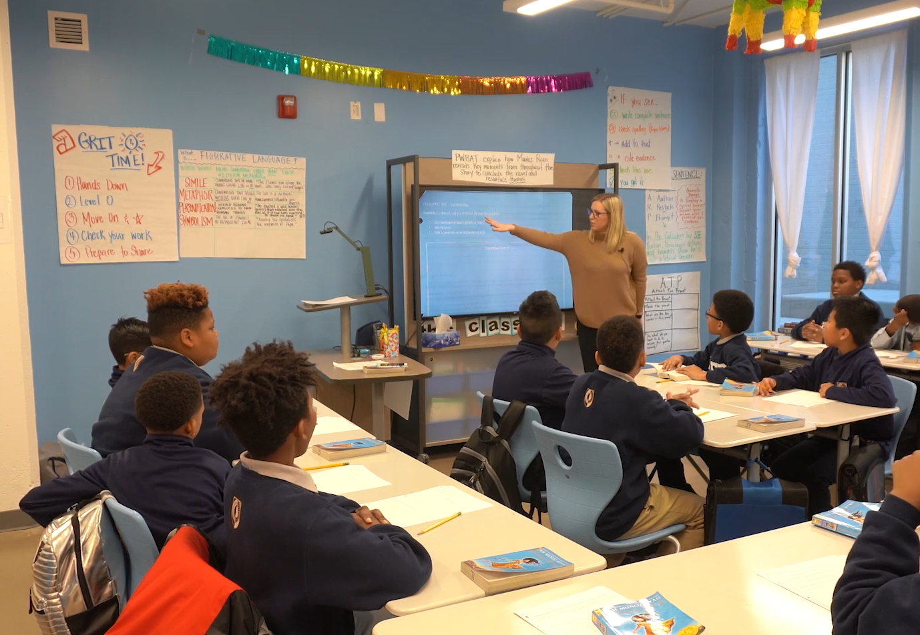
Sarah Wright
How does Sarah maintain engagement during the Do Now review?
Notes:
Clip Title: EA.EverybodyWrites.GR6.Wright.’You are Tio Luis.’Clip2891
Watch the clip here: [Box link]
Context:
In this clip, Sarah Wright leads a lesson from the unit for Esperanza Rising, by Pam Munoz Ryan, with a 6th grade class in Chattanooga, TN.
Sarah is reviewing the Do Now from Lesson 27, which asks students to take the perspective of Tío Luis when he discovers Abuelita has disappeared. Students have already written independently in response to the Do Now questions, and they have been challenged to use two vocabulary words of their choosing in their responses.
Alternative Framing Questions:
How does Sarah maintain strong pacing during the Do Now?
What does Sarah do to support the quality of student discussion?

Slide 11
Sarah Wright
Rigorous, engaging task
Varied Means of Participation
Supportive community
Momentum
Notes:
Notes on Student Engagement
Rigorous, engaging task: Sarah’s choice of activity is rich and engaging: not only does it involve both independent writing and whole-group discussion, but the “Because, But, So” question serves as a starting point for several recall questions about plot points (“What was her opinion?” “And what was the dream that he believed in?”), along with encouraging explicit vocabulary use and a range of correct answers (“Lavare, I agree with both you and Akeem…”). The task, as Sarah explains, both reviews previous material and sets a foundation for today’s lesson.
Varied Means of Participation: Sarah keeps engagement high by using several different Means of Participation: students write, Turn and Talk, raise their hands, chorally respond, and see their work projected in a Show Call. Sarah has also normed gestures of support, so even when the students are not actively speaking, they are still actively engaged in listening to the discussion.
Supportive community: Sarah’s positivity models excitement for the content, and her active listening shows every student that their answers are valued. Her expectations that her students focus on their peers when they are speaking and show them some love when they are thinking builds a safe community.
Momentum: Sarah concludes the Do Now review with a Turn and Talk during which she dramatically challenges students to “Be Tio Lous!” Ending the Do Now on such a high (and fun!) note will maintain engagement and momentum into the heart of her lesson.
You might also consider this clip for:
Show Call
Developmental Writing
Pacing
FAQs
How does Sarah maintain pacing during the Do Now?
Sarah has observed her students’ work during the Do Now itself, so she can Show Call s strong answer to get students started. She listens carefully to student responses, so she is able to sprinkle in related, supporting questions that require different voices to answer, creating a sense of fast-paced flow. Sarah’s Means of Participation vary, so the Do Now review does not lag. Sarah’s excitement, conveyed through her voice and her brisk steps around the classroom, can’t help but transfer to her students.

